Slide 1

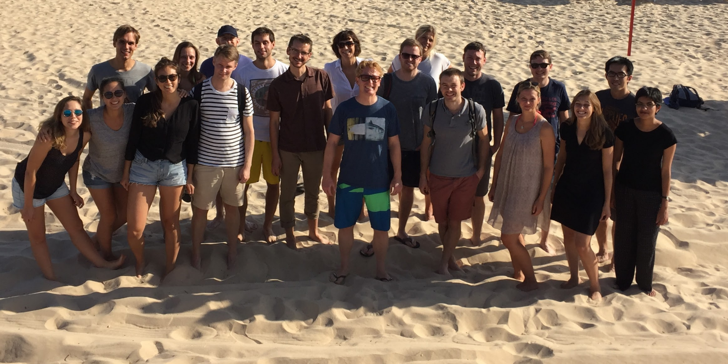
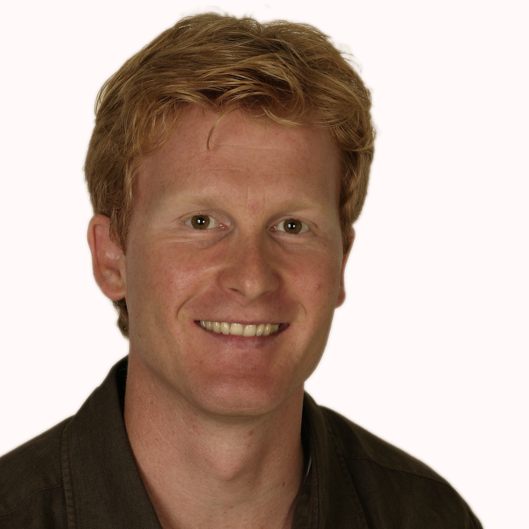
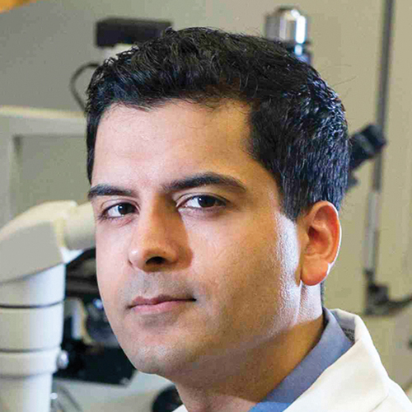


Acknowledgements
Steinmetz Lab
Lin Gen
Sibylle Vonesch
Bianca Henning
Cosimo Jann
Andreas Johansson
Jaffrey Lab
Funding:
Anya Grozhik
Anthony Olarerin-George

